Slide 1
GXTT GLVN
Văn Phòng Ban Giám Thị
March 16, 2014
Nguyễn Danh
Nguyễn Sy~

Slide 2
Contents
1) BGT Status Report
2) Support Needs
3) Safety Drills
a) Procedures
b) Timing
4) Q&A

Slide 3


BGT Report
1) BGT overall support has been very positive
2) An Toàn & An Ninh- Safety & Security
Đưa đón – Drop-off & Pick-up Procedures
  Xin Đúng giờ - On Time
  Xin tuân theo hướng dẩn xe cộ - Adhere to the Traffic procedures
Đi học - Attendance Process
  Xin Đúng giờ - On Time
  Trễ học và vắng mặt xin lien lac - Tardy and Absence protocol
3) Nghiêm Chỉnh & Nghiêm Trang – Orderly & Respectful
Quần áo đi học - School Dress code
  Đồng phục - Uniform
  Ăn mặc đứng đắn - Dress appropriately/respectfully
  Trong trường và nhà thờ - School & Church
Tham dự thánh lễ - Attending Mass Expectations:
  Giử im lặng, cầu nguyện - Quiet & Meditate
  Tôn trọng và chấp hành - Respectful and Observance

Slide 4
BGT Support Needs
Reiterate:
  Safety and security protocol
  Attendance process
  Dress code
  Attending mass expectations

Slide 5
BGT Safety Drills Planning
Fire Escape Route posted on each classrooms
Routes & Procedures for Fire & Tornado completed
Folder with procedures will be distributed next week
Need lockdown procedures (anh Danh??)
Fire Drill – March 30th (Backup: April 6th)
Tornado Drill – April 6th (Backup: March 30th)
Must gather, prep, and assigned BGT volunteers
  Meet on March 23rd
  Wear red uniforms on scheduled drill dates

Slide 6
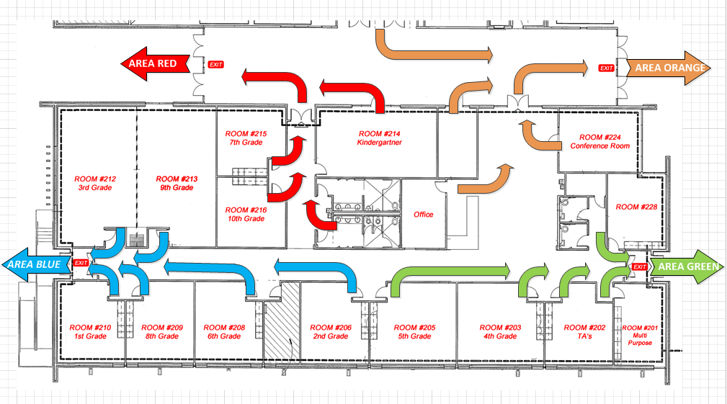
Fire Drill Escape Route

Slide 7
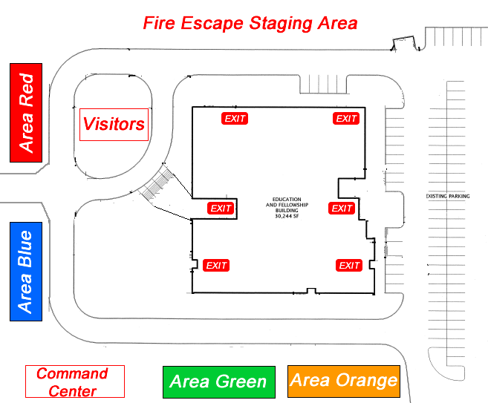

Slide 8
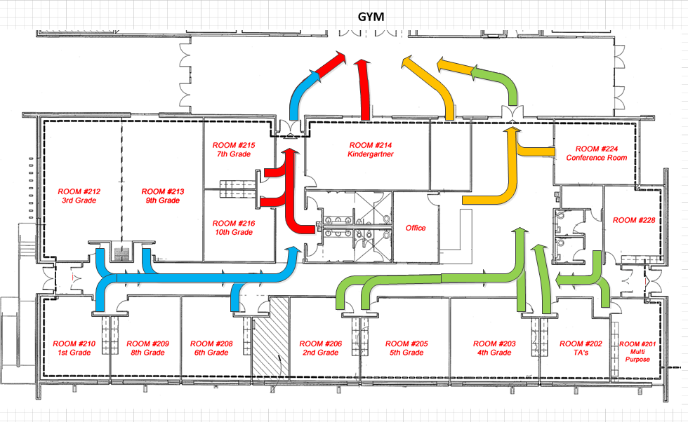
Tornado Drill

Slide 9
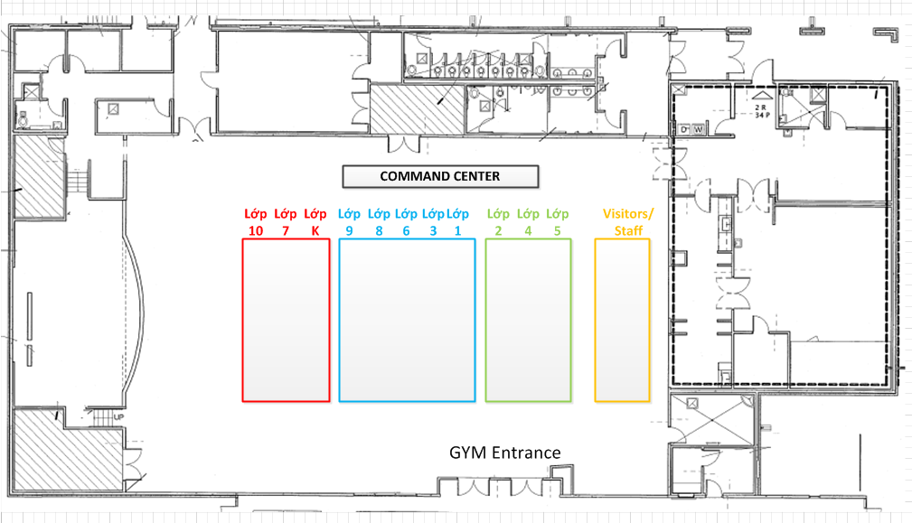
Tornado Staging Area

Slide 10
Thank you

